Slide 1
Case Study:
Sleep Habits
Sleep habit takeaways from 2013-2016
By: Sarah Schwartz
December 2021

Slide 2
Problem
Solution
Need to understand sleep quality so that active steps can be taken to improve it.
Analyze the sleep data collected to try to understand what external factors impact the quality of sleep.

Slide 3
Analytical Goals
Quantify the average hours of sleep for each year, quarter, month and day of the week.
Determine which month and which day of the week have the highest sleep quality.
Determine if the quality of sleep is better during the weekends or the weekdays.

Slide 4
About the data
The data was collected from an Basis B1 fitness tracker.
Weekend nights were defined as Friday and Saturday nights.
Data Limitations
Data was only collected when the user was wearing the fitness tracker.
Not all sleep events were captured.
Detailed sleep phases were not captured from 1/1/2013 to 1/14/2014
These dates were not included in the detailed sleep analysis

Slide 5
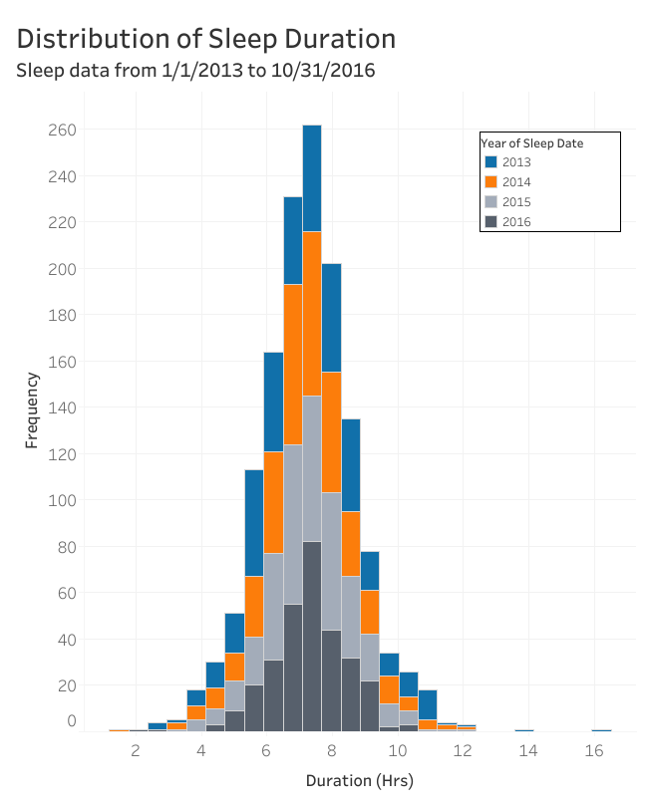
Average Sleep Duration
The average sleep duration was 7.26 ± 1.47 hours over the 1,372 days recorded.

Slide 6
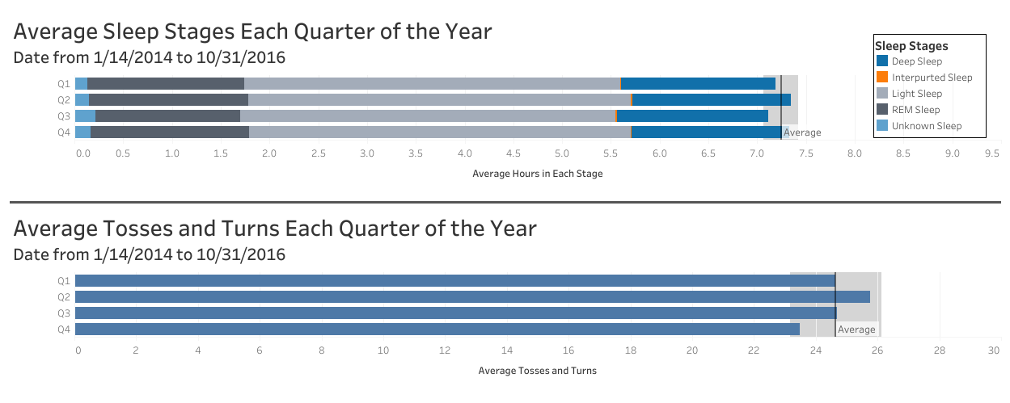
Sleep Quality:
Quarter
There are no statistically significant difference in the sleep duration or the number of tosses and turns between the different quarters of the year.

Slide 7
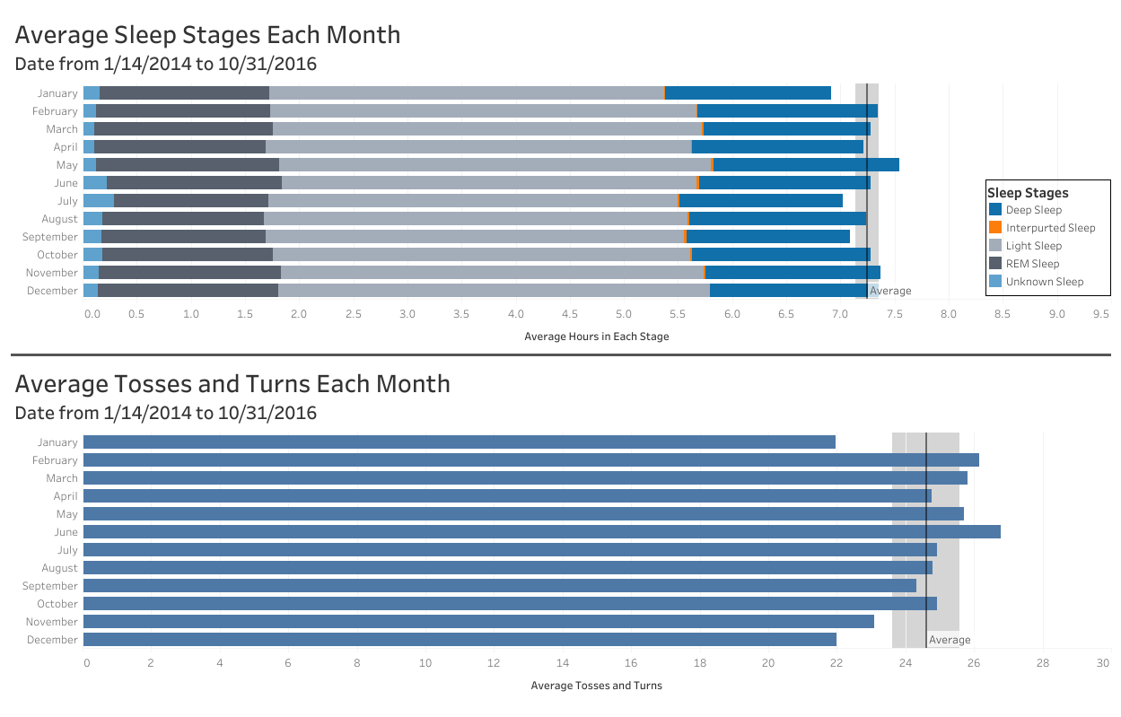
Sleep Quality:
Month
Sleep duration was significantly longer during May and significantly shorter during January.
These months line up with the start and end of the spring semester, which may contribute to these outliers.
Notes:
Note: sleep likely dropped again in June and July due to the individual taking summer classes that were during those months

Slide 8
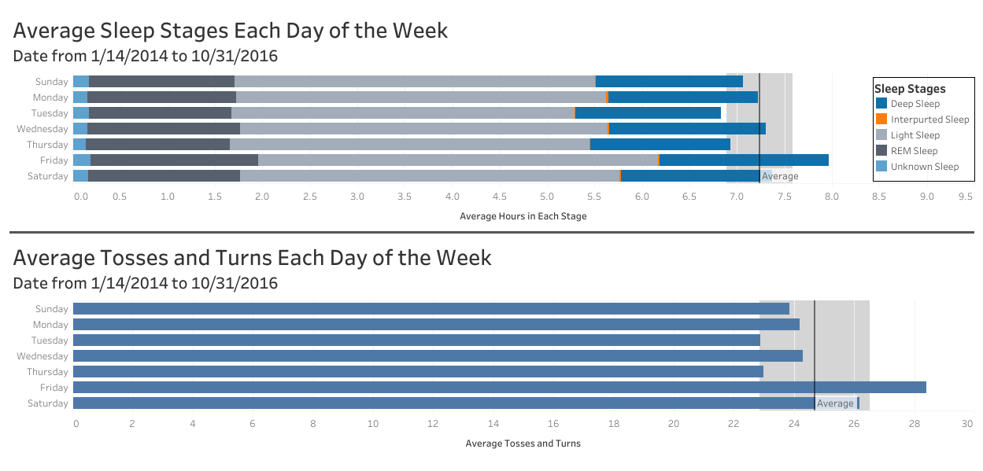
Sleep Quality:
Day of the Week
Tuesday/Thursday class schedule may have led to waking earlier and not sleeping as long on these days.
The average number of tosses and turns correlate with the length of sleep duration, which indicates that the sleep quality does not necessarily correlate to sleep duration.
Notes:
N

Slide 9
Takeaways
The sleep duration does not necessarily correlate with sleep quality.
The duration of each sleep stage and tosses and turns correlate to the sleep duration in a positively.
Sleep duration does correlate to class schedules.
The month of May has a significantly higher average sleep duration likely due to it being the month with the fewest days at school.
The average sleep duration over the entire period was within the recommended sleep range.
The Mayo Clinic recommends at least 7 hours of sleep for an adult.¹

Slide 10
Path forward
Collecting of more data including observational data could lead to improved recommendations of better sleep.
Examples of observational data includes:
Temperature of bedroom
Amount of physical activity during the day
Time before sleep of last meal
Mood before sleeping
The individual is no longer in university, so new sleep data would provide more relevant insight into their sleep quality.

Slide 11
Citations
[1] How many hours of sleep are enough for good health? By Eric J. Olson, M.D., Mayo Clinic

